Slide 1


“Information Security”
Lecture # 5
Dr. Engr. M Malook Rind
Ph.D (I.T), ME (CSN), MBA (MIS), BE (CS)
CCNA, CCNP, Juniper Certified.
Professor (Computer Science)

Slide 2
Contents
Penetration Testing
The Incident Response Process
Cryptography
Dr. M Malook Rind Information Security Lecture 5

Slide 3
Penetration Testing
Dr. M Malook Rind Information Security Lecture 5

Slide 4

Penetration Testing
Penetration testing attempts to exploit vulnerabilities in order to help:
Uncover new vulnerabilities
Provide a clearer picture of their nature
Determine how they could be used against the organization
The most important element in a “pen test” is the first step: planning
A lack of planning can result in creep, which is an expansion beyond the initial set of the test’s limitations
The most dangerous result of poor planning is creating unnecessary legal issues
Dr. M Malook Rind Advanced Information Security Lecture 5

Slide 5
Penetration Testing - Why Conduct a Test?
A scan of network defenses usually finds only surface problems to be addressed
Many network scans are automated and provide only limited verification of vulnerabilities
A penetration test can find deep vulnerabilities and attempts to exploit vulnerabilities using manual techniques
The attacks:
Must be the same as those used by a threat actor
Should follow the thinking of threat actors
Dr. M Malook Rind Advanced Information Security Lecture 5

Slide 6
Penetration Testing - Who Should Perform the Test?
One of the first questions to answer is who should conduct the penetration test. Should it be conducted by in-house employees or an external consultant? Is there another option? What are the advantages and disadvantages to each approach?
Internal Security Personnel
Advantages to using internal employees include:
There is little or no additional cost
The test can be conducted much more quickly
An in-house pen test can be used to enhance the training of employees and raise the awareness of security risks
Disadvantages of using internal security employees:
Inside knowledge
Lack of expertise
Reluctance to reveal
Dr. M Malook Rind Advanced Information Security Lecture 5

Slide 7
Penetration Testing - Who Should Perform the Test?
External Pen Tester Consultants
Contracting with an external pen testing consultant offers the following advantages:
Expertise
Credentials
Experience
Focus
A disadvantage of using external consultants is the usage of the information uncovered
A contractor who conducts a pen test learns all about an organization’s network and may receive extremely sensitive information about systems and how to access them
This knowledge could be sold to a competitor
Dr. M Malook Rind Advanced Information Security Lecture 5

Slide 8
Penetration Testing - Who Should Perform the Test?
Crowdsourced Pen Testers
Some third-party organizations have begun offering crowdsourced pen testing.
Instead of contracting with a single external pen tester consulting organization, crowdsourced pen testing involves a large group of individuals who are not regular employees of the contractor.
These handpicked crowdsourced members of the security community test the security of the client
Advantages of crowdsourced pen testers include the following:
Faster testing, resulting in quicker remediation of vulnerabilities
Ability to rotate teams so different individuals test the system
Option of conducting multiple pen tests simultaneously
Dr. M Malook Rind Advanced Information Security Lecture 5

Slide 9
Penetration Testing - Rules of Engagement ?
Rules of engagement in a penetration test are its limitations or parameters.
Categories for rules of engagement are:
Timing
Scope
Authorization
Exploitation
Communication
Cleanup
Reporting
Dr. M Malook Rind Advanced Information Security Lecture 5

Slide 10
Penetration Testing - Rules of Engagement ?
Timing
The timing parameter sets when the testing will occur
Some considerations include: the start and stop dates of the test and should the active portions of the pen test be conducted during normal business hours
Scope
the scope is what should be tested. Scope involves several elements that define the relevant test boundaries:
Environment: Should the pen test be conducted on the live production environment?
Internal targets: Before starting a penetration test, all internal targets must be clearly identified for an external third party gray box test or white box test.
External targets: In some situations, a pen test may include testing a service or an application hosted by a third party. These targets may include cloud service providers or Internet service providers
Target locations: Because laws vary among states, provinces, and countries, testing planners must identify the physical location of the targets and, if necessary, adjust the scope of the test.
Other boundaries: In addition to technical boundaries, other boundaries should be considered. For example, does the pen test include physical security, such as fencing, cameras, and guards.
Dr. M Malook Rind Advanced Information Security Lecture 5

Slide 11
Penetration Testing - Rules of Engagement ?
Authorization
Authorization is the receipt of prior written approval to conduct the pen test
A formal written document must be signed by all parties before a pen test begins
Exploitation
The exploitation level in a pen test should be part of the scope that is discussed in the planning stages
Communication
The pen tester should communicate with the organization during the following occasions:
Initiation: Once the pen test has started, the organization should be notified that the process has begun
Incident response: If a pen tester can complete the initial vulnerability assessment without triggering the organization’s incident response mechanism, then a critical gap in the security structure has been ident
Status: Instead of waiting until the pen test is completed, it is better to provide periodic status reports to the organization’s management
Emergency: If the pen tester uncovers a critical vulnerability, it should be immediately reported to the organization’s management while the penetration test is paused.
Dr. M Malook Rind Advanced Information Security Lecture 5

Slide 12
Penetration Testing - Rules of Engagement ?
Cleanup
The pen tester must ensure that everything related to the pen test has been removed
Cleanup involves removing all software agents, scripts, executable binaries, temporary files, and backdoors from all affected systems
Any credentials that were changed should be restored and any usernames created should be removed
Reporting
Once the pen test is completed, a report should be generated to document its objectives, methods used, and results
The report should be divided into two parts:
An executive summary designed for a less technical audience
A more technical summary written for security professionals
Dr. M Malook Rind Advanced Information Security Lecture 5

Slide 13
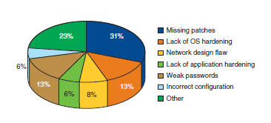
Penetration Testing - Rules of Engagement ?
Types of vulnerabilities
Dr. M Malook Rind Advanced Information Security Lecture 5

Slide 14
Penetration Testing - Performing a Penetration Test
Performing a successful pen test involves determination, resolve, and perseverance
A variety of actions take place when performing a pen test, however, they can be grouped into two phases:
Reconnaissance
Penetration
Dr. M Malook Rind Advanced Information Security Lecture 5

Slide 15
Penetration Testing - Performing a Penetration Test
Phase 1: Reconnaissance
The first task is to perform preliminary information gathering from outside the organization (called footprinting)
Information can be gathered using two methods: active reconnaissance and passive reconnaissance.
Active reconnaissance involves directly probing for vulnerabilities and useful information
War driving is searching for wireless signals from an automobile or on foot while using a portable device
War flying uses drones, which are officially known as unmanned aerial vehicles (UAVs)
A disadvantage of active reconnaissance is that the probes are likely to alert security professionals that something unusual is occurring
Passive reconnaissance occurs when the tester uses tools that do not raise any alarms
This may include searching online for publicly accessible information called open source intelligence (OSINT) that can reveal valuable insight about the system.
Dr. M Malook Rind Advanced Information Security Lecture 5

Slide 16
Penetration Testing - Performing a Penetration Test
Phase 2: Penetration
Because a pen test is intended to simulate the actions of a threat actor, the question becomes, “What do threat actors do when they uncover a vulnerability through reconnaissance?”
Threat actors follow these steps in an actual attack
1. The threat actors first conduct reconnaissance against the systems, looking for vulnerabilities.
2. When a path to a vulnerability is exposed, they gain access to the system through the vulnerability.
3. Once initial access is gained, the threat actors attempt to escalate to more advanced resources that are normally protected from an application or user. This is called privilege escalation.
4. With the advanced privileges, the threat actors tunnel through the network looking for additional systems they can access from their elevated position (called lateral movement).
5. Threat actors install tools on the compromised systems to gain even deeper access to the network.
6. Threat actors may install a backdoor that allows them repeated and long-term access to the system in the future. The backdoors are not related to the initial vulnerability, so access remains even if the initial vulnerability is corrected.
7. Once the backdoor is installed, threat actors can continue to probe until they find their ultimate target and perform their intended malicious action, such as stealing R&D information, password files, or customer credit card numbers.
Dr. M Malook Rind Advanced Information Security Lecture 5

Slide 17
The Incident Response Process
Dr. M Malook Rind Information Security Lecture 5

Slide 18
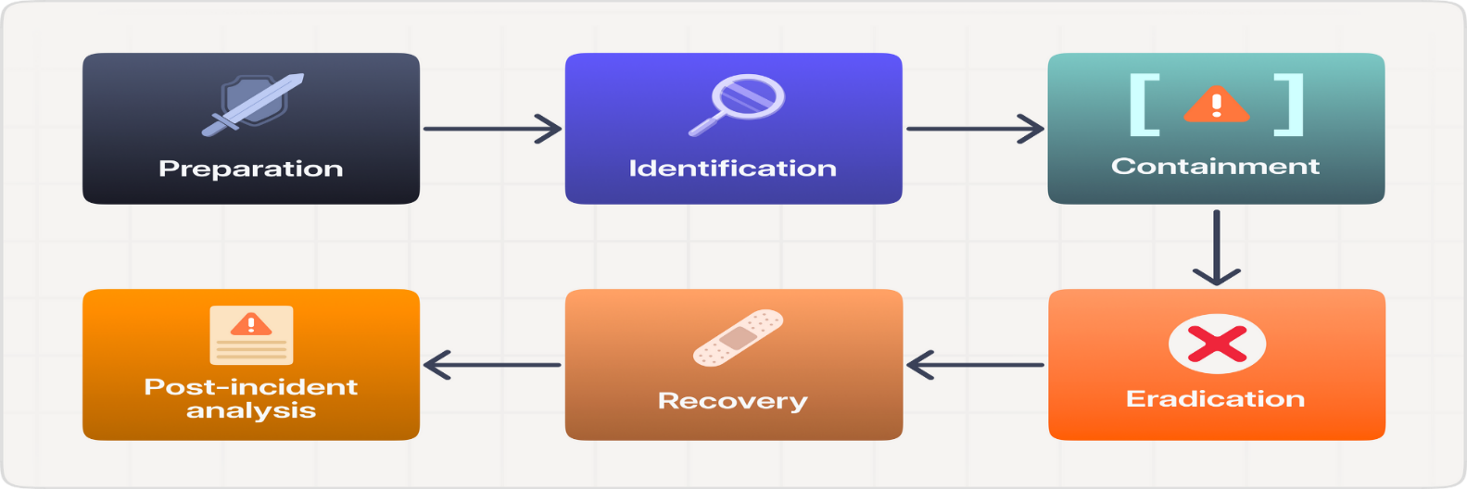
Preparing for an Incident
Due to weak account types, poor access control, and other vulnerabilities that lead to successful attacks, it is important to prepare in advance for an incident. The steps to take in preparation are creating an incident response plan, performing exercises, and studying attack frameworks.
Creating an Incident Response Plan: An incident response plan is a set of written instructions for reacting to a security incident. Without such a plan, enterprises are at risk of being unable to quickly identify the attack, contain its spread, recover, and learn from the attack to improve defenses. The six action steps to be taken when an incident occurs, called the incident response process, also make up the six elements of an incident response plan.
Dr. M Malook Rind Advanced Information Security Lecture 5

Slide 19
Preparing for an Incident
Creating an Incident Response Plan
Preparation Equipping IT staff, management, and users to handle potential incidents when they arise
Identification Determining whether an event is actually a security incident
Containment Limiting the damage of the incident and isolating those systems that are impacted to prevent further damage
Eradication Finding the cause of the incident and temporarily removing any systems that may be causing damage
Recovery After ensuring no threat remains, permitting affected systems to return to normal operation
Lessons learned Completing incident documentation, performing detailed analysis to increase security and
Dr. M Malook Rind Advanced Information Security Lecture 5

Slide 20
Cryptography
Dr. M Malook Rind Information Security Lecture 5

Slide 21
What is Cryptography?
Cryptography comes from the Greek words kryptos, meaning “hidden,” and graphein, meaning “to write,” and involves making and using codes to secure messages.
Scrambling information so it cannot be read
Transforms information into secure form so unauthorized persons cannot access it
Cryptography uses mathematical algorithms that are usually known to all. After all, it’s not the knowledge of the algorithm that protects the encrypted message, it’s the knowledge of the key—a series of characters or bits injected into the algorithm along with the original message to create the encrypted message.
Cryptology has an extensive, multicultural history. People have been making, using, and breaking codes for thousands of years, and they will not stop any time soon. Its history starts from 1900 B.C.
Cryptography played role in World War II,
Dr. M Malook Rind Advanced Information Security Lecture 5

Slide 22
What is Cryptography?
Steganography
Hides the existence of data
An image, audio, or video file can contain hidden messages embedded in the file
The process of hiding messages; for example, hiding a message within the digital encoding of a picture or graphic so that it is almost impossible to detect that the hidden message even exists.
Here are a few examples:
A hidden message that can be revealed by playing a video at a faster frame rate
Content that can be unveiled by playing an audio track backward
Embedding a message into an RGB image by hiding it in the red, green, or blue channel
Adding noise or sound to encrypt a message within a photo
Hiding content within the file header or metadata
Dr. M Malook Rind Advanced Information Security Lecture 5

Slide 23
What is Cryptography? – Key Terms
Encryption is the process of changing original text into a secret message using cryptography
Changing the secret message back to its original form is known as decryption
Plaintext is unencrypted data to be encrypted or is the output of decryption
Ciphertext is the scrambled and unreadable output of encryption
Cleartext data is data stored or transmitted without encryption
Plaintext data is input into a cryptographic algorithm (also called a cipher)
It consists of procedures based on a mathematical formula used to encrypt and decrypt the data
Cryptanalysis is the process of obtaining the plaintext message from a ciphertext message without knowing the keys used to perform the encryption.
Cryptology is the field of science that encompasses cryptography and cryptanalysis.
Dr. M Malook Rind Advanced Information Security Lecture 5

Slide 24
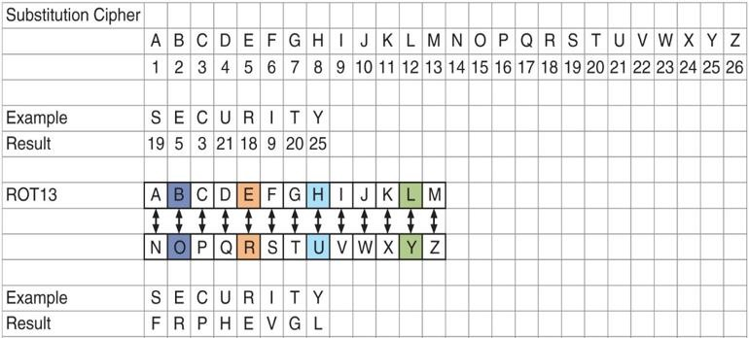
What is Cryptography?
A key is a mathematical value entered into the algorithm to produce ciphertext
The reverse process uses the key to decrypt the message
A substitution cipher substitutes one character for another
One type is a ROT13, in which the entire alphabet is rotated 13 steps (A=N)
Dr. M Malook Rind Advanced Information Security Lecture 5

Slide 25
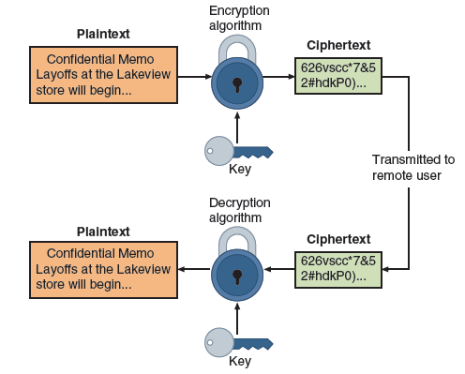
Cryptographic Process
Cryptographic process
Dr. M Malook Rind Advanced Information Security Lecture 5

Slide 26
Cryptography Use Cases
Cryptography can provide several basic protections
Confidentiality ensures only authorized parties can view it
Integrity ensures information is correct and unaltered
Authentication ensures sender can be verified through cryptography
Nonrepudiation proves that a user performed an action
Obfuscation is making something obscure or unclear
Security through obscurity
An approach in security where virtually any system can be made secure as long as outsiders are unaware of it or how it functions
Cryptography can provide protection to data as that data resides in any of three states:
Data in processing (also called data in use) is data actions being performed by “endpoint devices”
Data in transit are actions that transmit the data across a network
Data at rest is data that is stored on electronic media
Dr. M Malook Rind Advanced Information Security Lecture 5

Slide 27
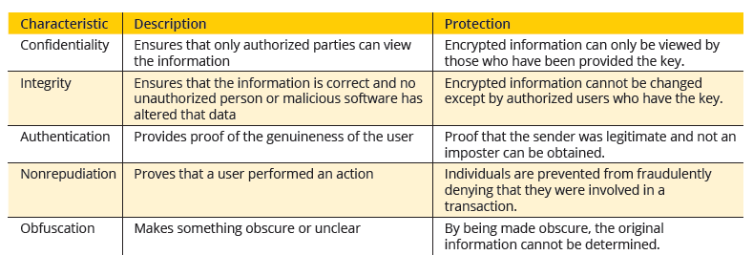
What is Cryptography?
The security protections afforded by cryptography are
Information protections by cryptography
Dr. M Malook Rind Advanced Information Security Lecture 5

Slide 28
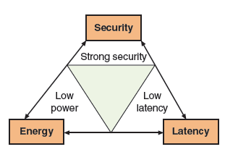
Limitations of Cryptography
Despite providing widespread protections, cryptography faces constraints (limitations) that can impact its effectiveness.
In recent years, the number of small electronic devices that consume little power (low-power devices) has grown significantly.
a cryptographic algorithm should have low latency, or a small amount of time that occurs between when a byte is input into a cryptographic algorithm and the time the output is obtained
Dr. M Malook Rind Advanced Information Security Lecture 5

Slide 29
Cryptographic Algorithms
A fundamental difference in cryptographic algorithms is the amount of data processed at a time
Stream cipher - Stream ciphers convert one symbol of plaintext directly into a symbol of ciphertex.
Stream ciphers encrypt data by generating a stream of random bits, called a keystream, and combining it with the plaintext using a bitwise operation, such as XOR.
Block cipher - encrypt a group of plaintext symbols as one block. The message is divided into blocks—for example, sets of 8-, 16-, 32-, or 64-bit blocks—and then each block of plaintext bits is transformed into an encrypted block of cipher bits using an algorithm and a key.
Dr. M Malook Rind Advanced Information Security Lecture 5

Slide 30
Cryptographic Algorithms
Three categories of cryptographic algorithms
Hash algorithms
Symmetric cryptographic algorithms
Asymmetric cryptographic algorithms
Dr. M Malook Rind Advanced Information Security Lecture 5

Slide 31
Cryptographic Algorithms - Hash Algorithms
Hashing is the process of using a mathematical function to convert input data into a fixed-length output. Primarily used for integrity purpose.
Hash algorithm creates a unique “digital fingerprint” of a set of data and is commonly called hashing
This fingerprint, called a digest (sometimes called a message digest or hash), represents the contents
Hashing is a unidirectional process that is impossible to work backwards to retrieve the original data.
The output hash is a fixed-length hexadecimal string of several characters.
An efficient hashing algorithm does not generate the same hash value for two different inputs.
A hashing algorithm is considered secure if it has the following characteristics:
Fixed size - short and long data sets have the same size hash
Unique - two different data sets cannot produce the same hash
Original - data set cannot be created to have a predefined hash
Secure - resulting hash cannot be reversed to determine original plaintext
Dr. M Malook Rind Advanced Information Security Lecture 5

Slide 32
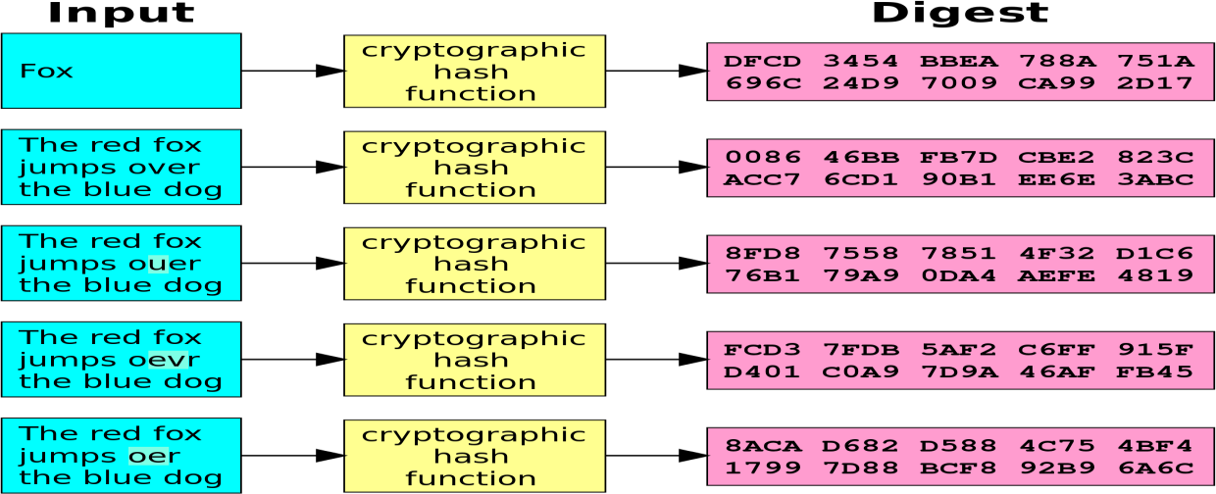
Cryptographic Algorithms - Hash Algorithms
Dr. M Malook Rind Advanced Information Security Lecture 5

Slide 33
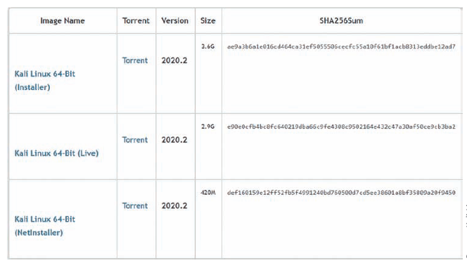
Cryptographic Algorithms - Hash Algorithms
Dr. M Malook Rind Advanced Information Security Lecture 5

Slide 34
Cryptographic Algorithms - Hash Algorithms
Common hash algorithms include the following:
• Message Digest (MD). One of the earliest hash algorithms is a “family” of algorithms known as Message Digest (MD). Versions of MD hashes were introduced over almost 20 years, from MD2 (1989) to MD6 (2008). The most widely used of these algorithms is MD5. Serious weaknesses have been identified in MD5, and it is no longer considered suitable for use.
• Secure Hash Algorithm (SHA). Another family of hashes is the Secure Hash Algorithm (SHA). SHA-1 was developed in 1993 but is no longer considered suitable for use. SHA-2 has six variations, the most common are SHA-256, SHA-384, and SHA-512 (the last number indicates the length in bits of the digest that is generated) and is currently considered a secure hash. In 2015, after eight years of competition between 51 original entries, SHA-3 was announced as a new standard.
• RIPEMD. RIPEMD stands for RACE Integrity Primitives Evaluation Message Digest. The primary design feature of RIPEMD is two different and independent parallel chains of computation, the results of which are then combined at the end of the process. All versions of RIPEMD are based on the length of the digest created, including RIPEMD-128, RIPEMD-256, and RIPEMD-320.
Dr. M Malook Rind Advanced Information Security Lecture 5

Slide 35
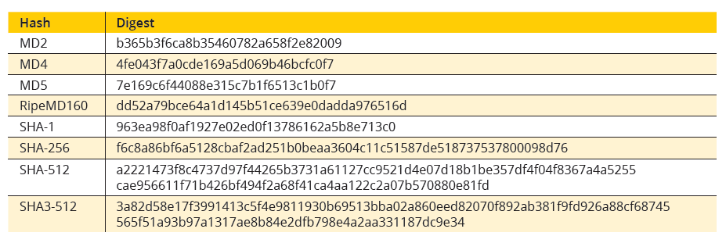
Cryptographic Algorithms - Hash Algorithms
Dr. M Malook Rind Advanced Information Security Lecture 5

Slide 36
Cryptographic Algorithms - Symmetric Cryptographic Algorithms
Symmetric cryptographic algorithms use the same single key to encrypt and decrypt a document.
Because the key must be kept private (confidential) symmetric encryption is also called private key cryptography (the key is kept private between sender and receiver).
Symmetric cryptography can provide strong encryption—if the key is kept secure between the sender and all the recipients
Common Symmetric cryptographic algorithms include:
Data Encryption Standard (DES)
Triple Data Encryption Standard (3DES)
Advanced Encryption Standard (AES)
Rivest Cipher (RC)
Blowfish
Dr. M Malook Rind Advanced Information Security Lecture 5

Slide 37
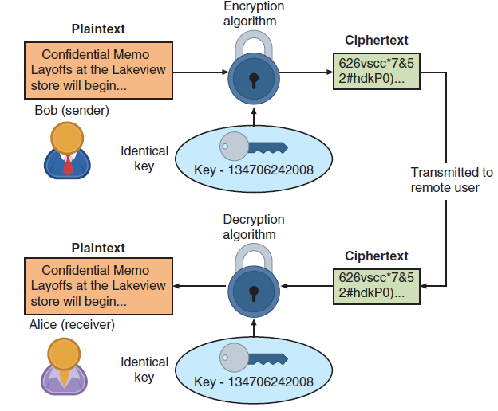
Cryptographic Algorithms - Symmetric Cryptographic Algorithms
Symmetric cryptographic algorithms use the same single key to encrypt and decrypt a document.
Because the key must be kept private (confidential) symmetric encryption is also called private key cryptography (the key is kept private between sender and receiver).
Symmetric cryptography can provide strong encryption—if the key is kept secure between the sender and all the recipients.
Dr. M Malook Rind Advanced Information Security Lecture 5

Slide 38
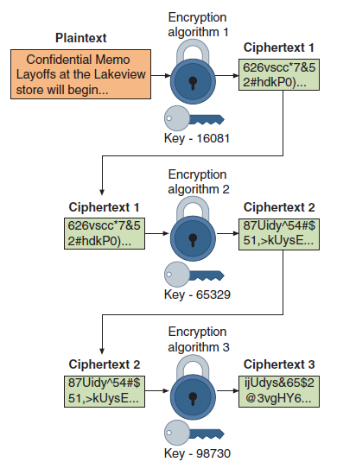
Cryptographic Algorithms - Symmetric Cryptographic Algorithms
Common algorithms include:
Data Encryption Standard (DES): One of the first widely used symmetric cryptography algorithms. But now it is no longer considered suitable for use.
Triple Data Encryption Standard (3DES): was designed to replace DES. As its name implies, 3DES uses three rounds of encryption instead of just one. The ciphertext of one round becomes the entire input for the second iteration. 3DES employs a total of 48 iterations in its encryption (3 iterations 3 16 rounds).
Advanced Encryption Standard (AES): U.S (NIST) introduced in 2001. AES is widely used today as it is a much stronger than DES and triple DES despite being harder to implement. The key size can be 128/192/256 bits. Encrypts data in blocks of 128 bits each.
Rivest Cipher (RC): RC4, the most common RC cipher, is a stream cipher that accepts keys up to 128 bits in length
Blowfish: is a block cipher algorithm that operates on 64-bit blocks and can have a key length from 32 to 448 bits. To date, no significant weaknesses have been identified.
Dr. M Malook Rind Advanced Information Security Lecture 5

Slide 39
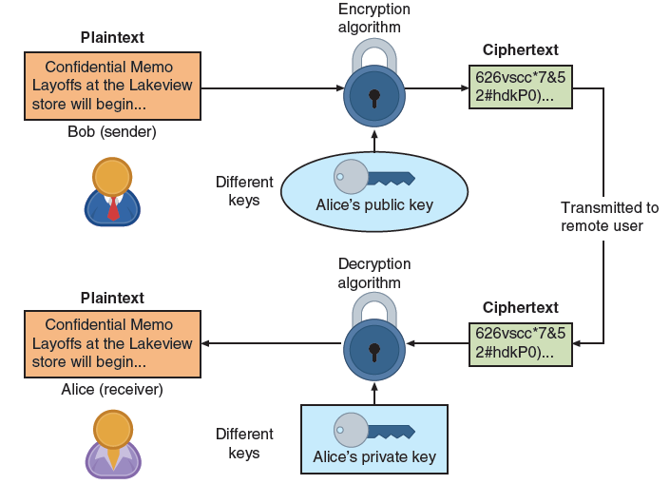
Cryptographic Algorithms - Asymmetric Cryptographic Algorithms
The primary weakness of symmetric algorithms: distributing (Exchange) and maintaining a secure single key among multiple users distributed geographically poses challenges.
Asymmetric cryptographic algorithms use two mathematically related keys (known as the public key and the private key)
Also known as public key cryptography
Public key available to everyone and freely distributed
Private key known only to individual to whom it belongs
When Bob wants to send a secure message to Alice, he uses Alice’s public
key to encrypt the message. Alice then uses her private key to decrypt it.
Dr. M Malook Rind Advanced Information Security Lecture 5

Slide 40
Cryptographic Algorithms - Asymmetric Cryptographic Algorithms
Several important principles regarding asymmetric cryptography are as follows:
Key pairs : Unlike symmetric cryptography that uses only one key, asymmetric cryptography requires a pair of keys.
Public key: Public keys, by their nature, are designed to be public and do not need to be protected. They can be freely given to anyone or even posted on the Internet.
Private key: The private key must be kept confidential and never shared.
Both directions - keys can work in both directions. A document encrypted with a public key can be decrypted with the corresponding private key. In the same way, a document encrypted with a private key can be decrypted with its public key.
Dr. M Malook Rind Advanced Information Security Lecture 5

Slide 41
Cryptographic Algorithms - Digital Signature Algorithm (DSA)
A digital signature is an electronic, encrypted, stamp of authentication on digital information such as email messages, macros, or electronic documents.
A valid digital signature on a message gives a recipient confidence that the message came from a sender known to the recipient
A digital signature can
• Verify the sender. A digital signature serves to confirm the identity of the person from whom the electronic message originated.
• Prevent the sender from disowning the message. The signer cannot later attempt to disown it by claiming the signature was forged (nonrepudiation).
• Prove the integrity of the message. A digital signature can prove that the message has not been altered since it was signed.
Dr. M Malook Rind Advanced Information Security Lecture 5

Slide 42
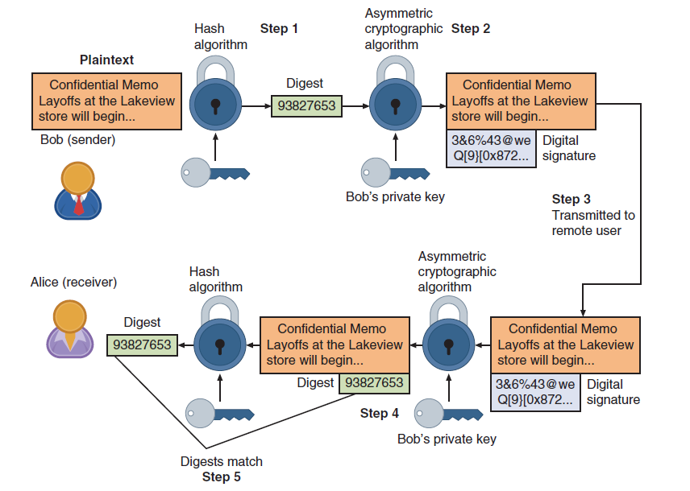
Cryptographic Algorithms - Digital Signature Algorithm (DSA)
The steps for Bob to send a digitally signed message to Alice are as follows:
1. After creating a memo, Bob generates a digest on it.
2. Bob encrypts the digest with his private key. The encrypted digest is the digital signature for the memo.
3. Bob sends both the memo and the digital signature to Alice.
4. When Alice receives them, she decrypts the digital signature using Bob’s public key, revealing the digest. If she cannot decrypt the digital signature, then she knows that it did not come from Bob (because only Bob’s public key can decrypt the digest generated with his private key).
5. Alice then hashes the memo with the same hash algorithm Bob used and compares the result to the digest she received from Bob. If they are equal, Alice can be confident that the message has not changed since he signed it. If the digests are not equal, Alice will know the message has changed since it was signed.
Dr. M Malook Rind Advanced Information Security Lecture 5

Slide 43
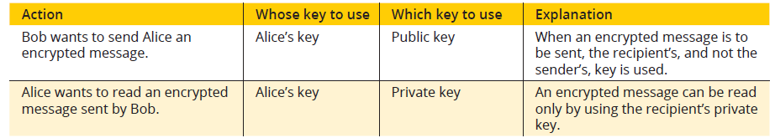
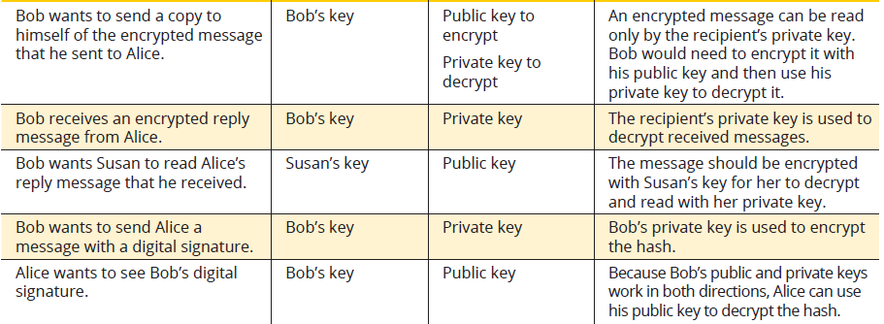
Cryptographic Algorithms - Asymmetric Cryptographic Algorithms
Dr. M Malook Rind Advanced Information Security Lecture 5

Slide 44
Cryptographic Attacks
Cryptography remains under attack by threat actors for any vulnerabilities
Two of the most common cryptography attacks are algorithm attacks and collision attacks
Algorithm Attacks
Very few threat actors have the advanced skills needed to even attempt to break an algorithm.
Methods attackers can use to circumvent strong algorithms:
Known ciphertext attacks
Cryptography prevents threat actors from knowing the plaintext or the key.
The only item they can see is the ciphertext itself.
Statistical tools can be used to attempt to discover a pattern in the ciphertexts, which can then be used to reveal the plaintext or key
Downgrade Attack
An attacker forces the system to abandon the current higher security mode of operation and instead “fall back” to implementing an older and less secure mode. The threat actor can then attack the weaker mode
Downgrade Attack
Result of incorrect choices or misconfigurations of the cryptography options.
Algorithm Attacks
When two files have the same digest this is known as a collision.
A collision attack is an attempt to find two input strings of a hash function that produce the same hash result
Dr. M Malook Rind Advanced Information Security Lecture 5

Slide 45
Using Cryptography
Cryptography can be applied through either:
Software
Hardware.
A relatively new technology known as blockchain uses cryptography as its basis.
Dr. M Malook Rind Advanced Information Security Lecture 5

Slide 46
Using Cryptography - Encryption through Software
File and File System Cryptography
Encryption software can be used to encrypt or decrypt files one-by-one (a cumbersome process)
Protecting groups of files can take advantage of the OS’s file system
Third-party software tools available for encryption include GNU Privacy Guard (GNuPG), AxCrypt, Folder Lock, and VeraCrypt
Operating System Encryption
Microsoft Windows Encrypting File System (EFS) is a cryptography system for Windows
EFS uses NTFS file system.
Any file created in an encrypted folder or added to an encrypted folder is automatically encrypted.
Full Disk Encryption (FDE)
FDE protects all data on a hard drive
Example: BitLocker drive encryption software that is included in Microsoft Windows
BitLocker encrypts the entire system volume, including the Windows Registry
Prevents attackers from accessing data by booting from another OS or placing the hard drive in another computer
Dr. M Malook Rind Advanced Information Security Lecture 5

Slide 47
Using Cryptography - Blockchain
A blockchain is a shared, immutable ledger that facilitates the process of recording transactions and tracking assets in a business network
Blockchain technology allows a network of computers to agree at regular intervals on the true state of a distributed ledger
It is a system in which a record of transactions made is maintained across
several computers that are linked in a peer-to-peer network
Blockchain relies on cryptographic hash algorithms to records its transactions
Dr. M Malook Rind Advanced Information Security Lecture 5

Slide 48
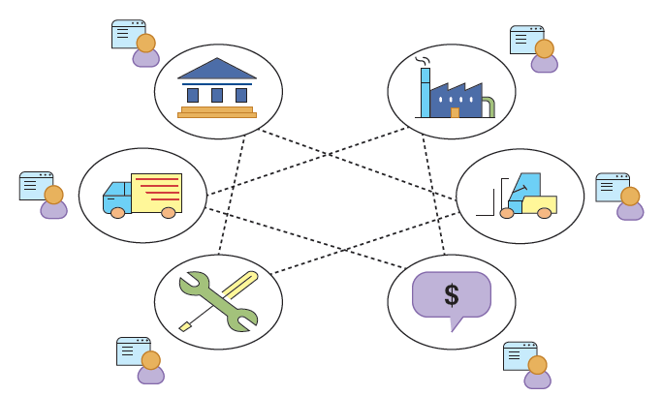
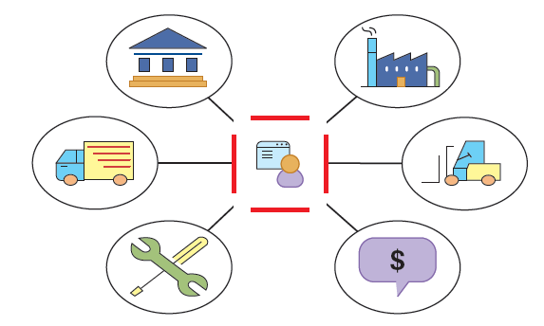
Using Cryptography - Blockchain
Multiple organizations with ledgers
Multiple organizations using single ledger
Dr. M Malook Rind Advanced Information Security Lecture 5

Slide 49
Thanks
Dr. M Malook Rind Information Security Lecture 5

